Slide 1
BCCA figures
March 13 2025

Slide 2
Data % to report
X2.1.Flow.Type n prop
<chr> <int> <dbl>
1 Biotic 113 0.551
2 Human movement 21 0.102
3 Physical 38 0.185
4 Sociocultural 33 0.161

Slide 3
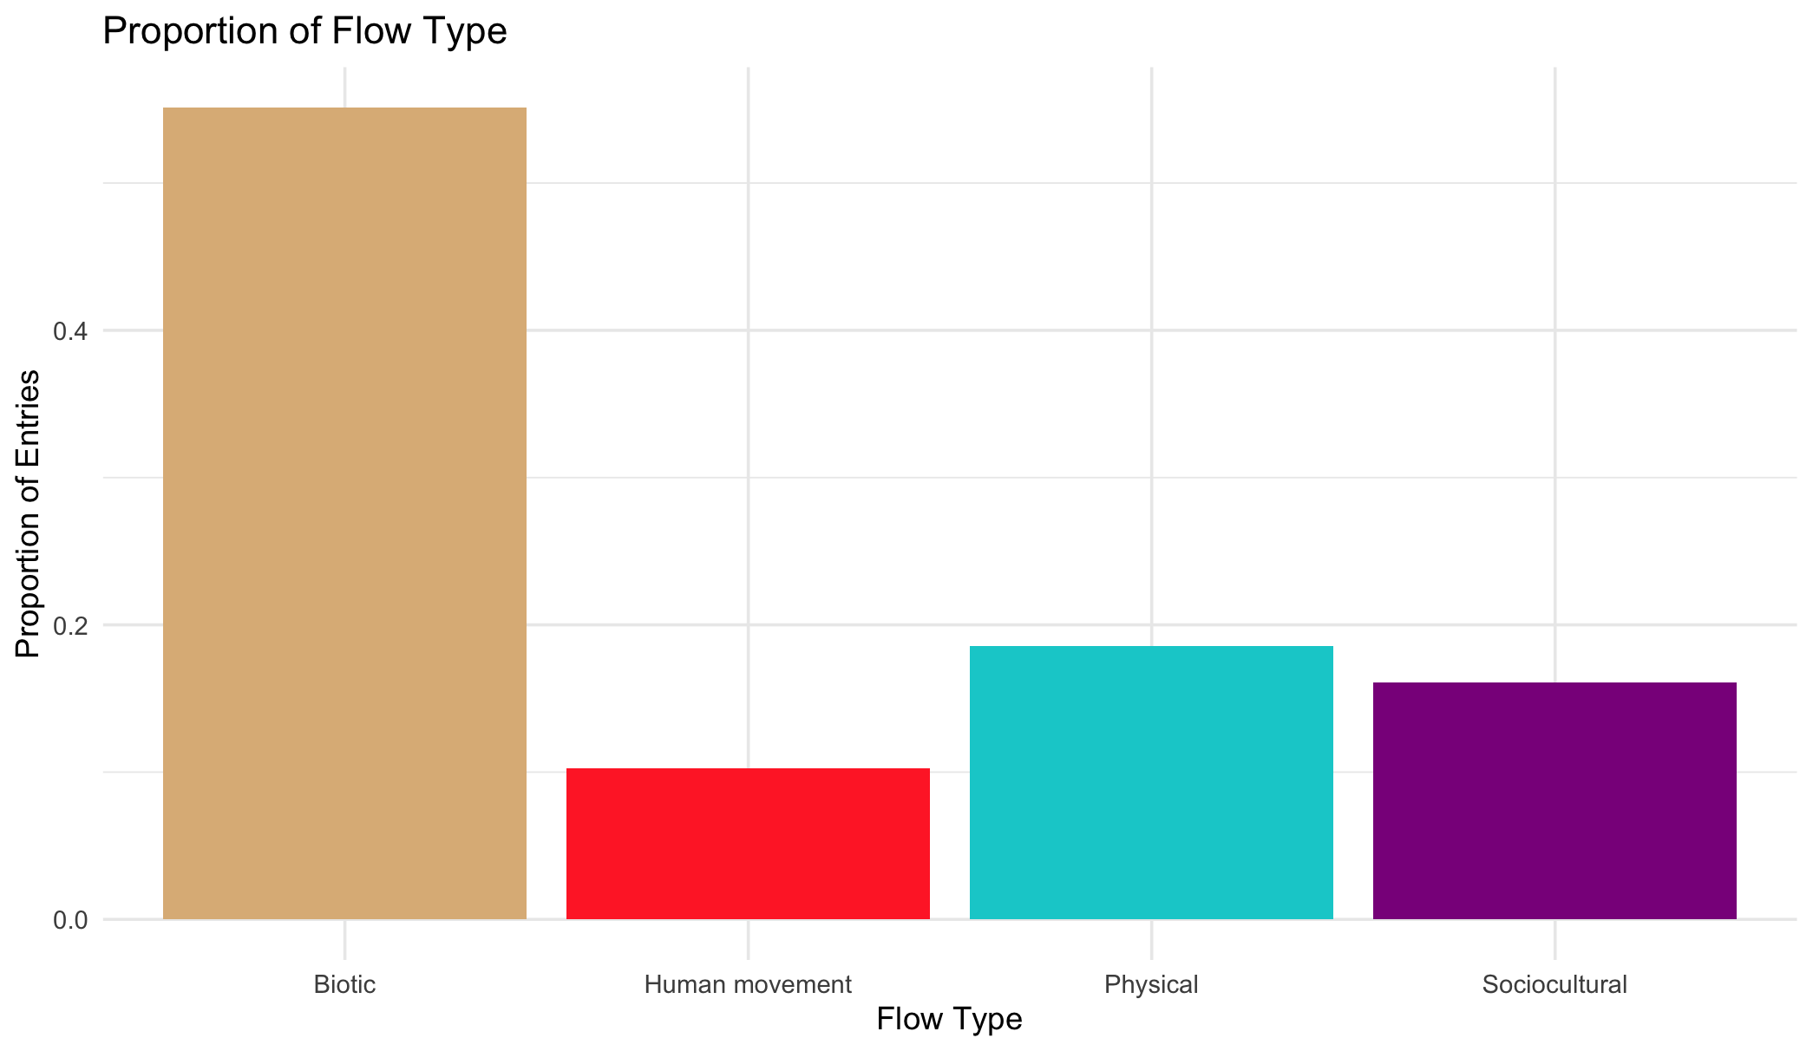

Slide 4
Multiple flows
Another.Flow. n prop
1 No 168 0.820
2 Yes 37 0.180

Slide 6
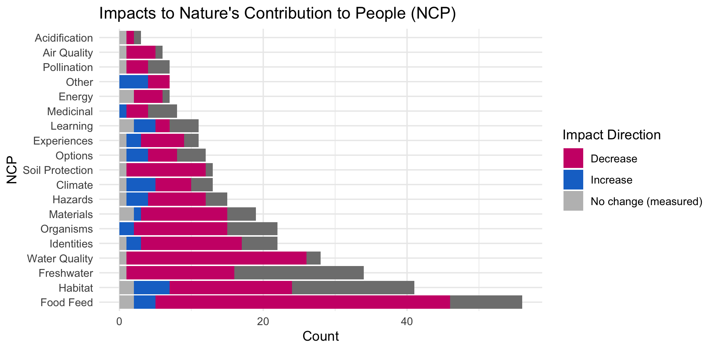

Slide 8
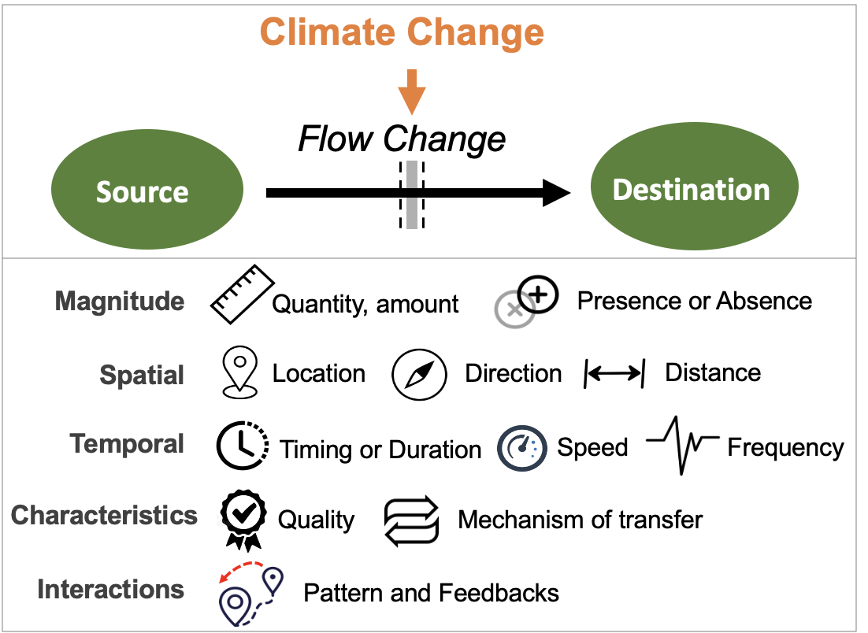
Most common paths
Climate change →

Slide 9
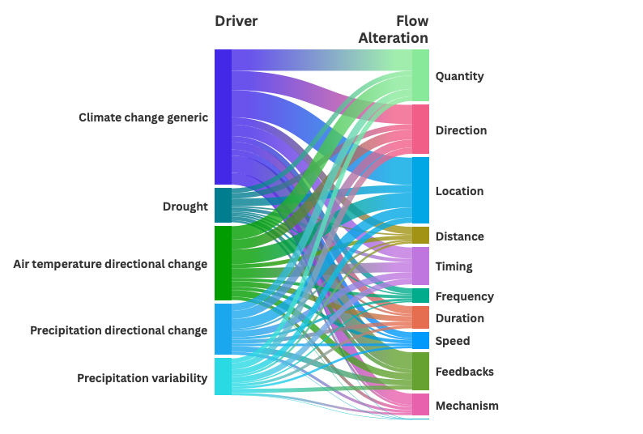

Slide 11
OLDER:

Slide 13
At least 5 entries – top – to get stats on % of entries or papers on these:

Slide 14
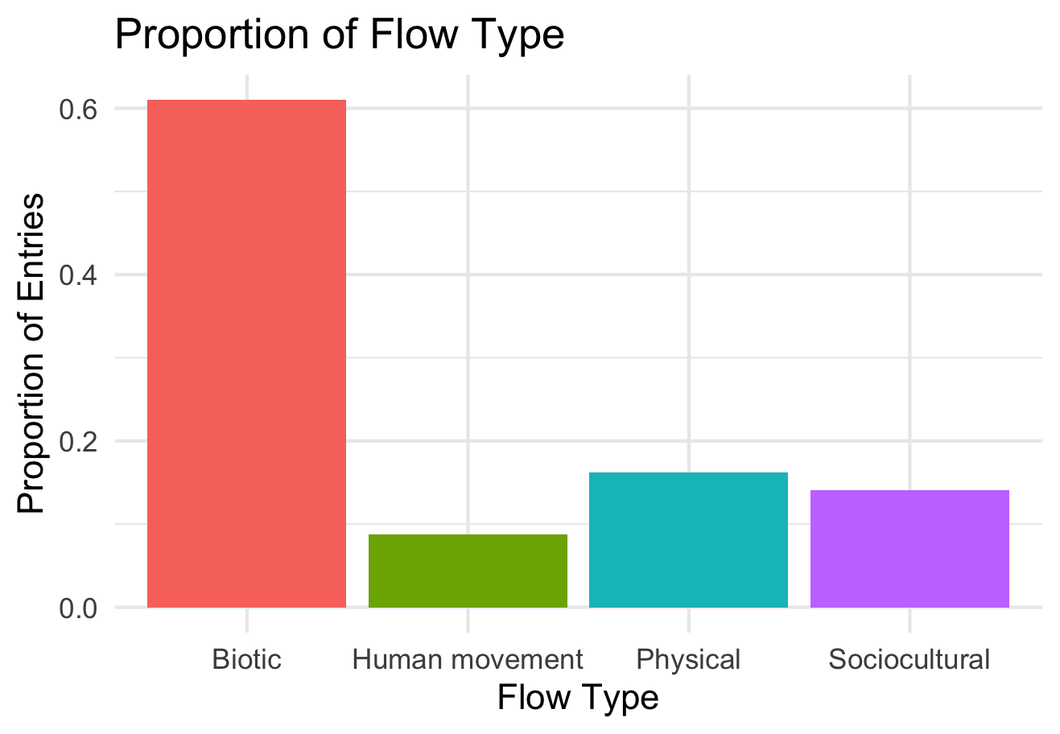

Slide 15
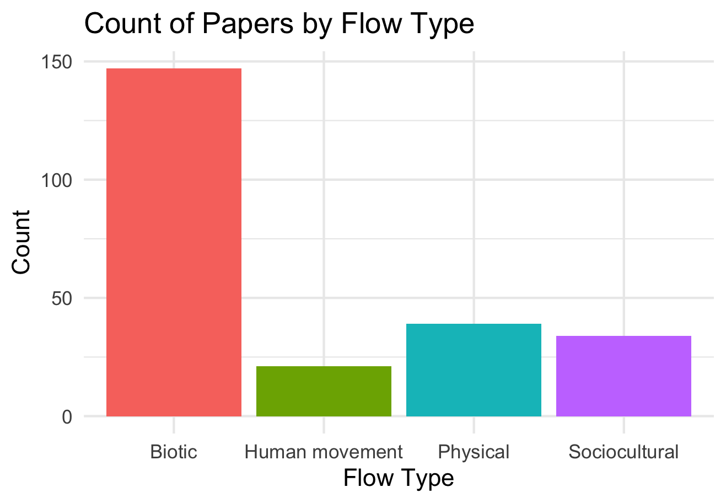

Slide 16
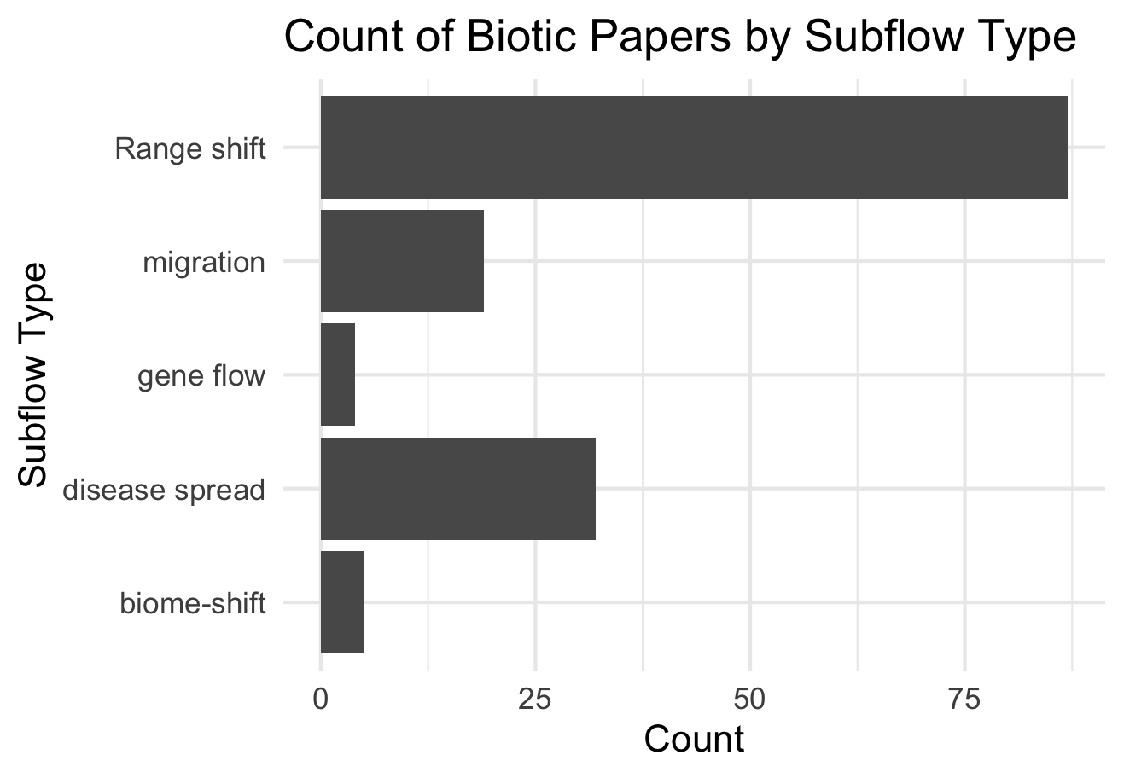

Slide 17
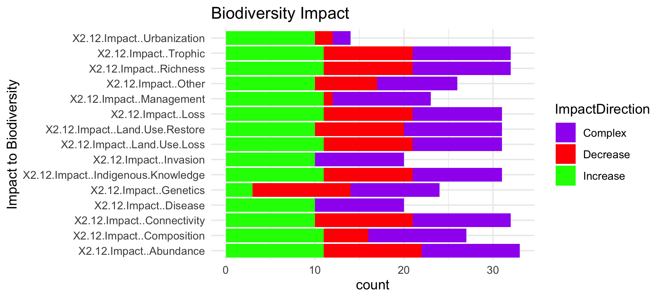

Slide 19
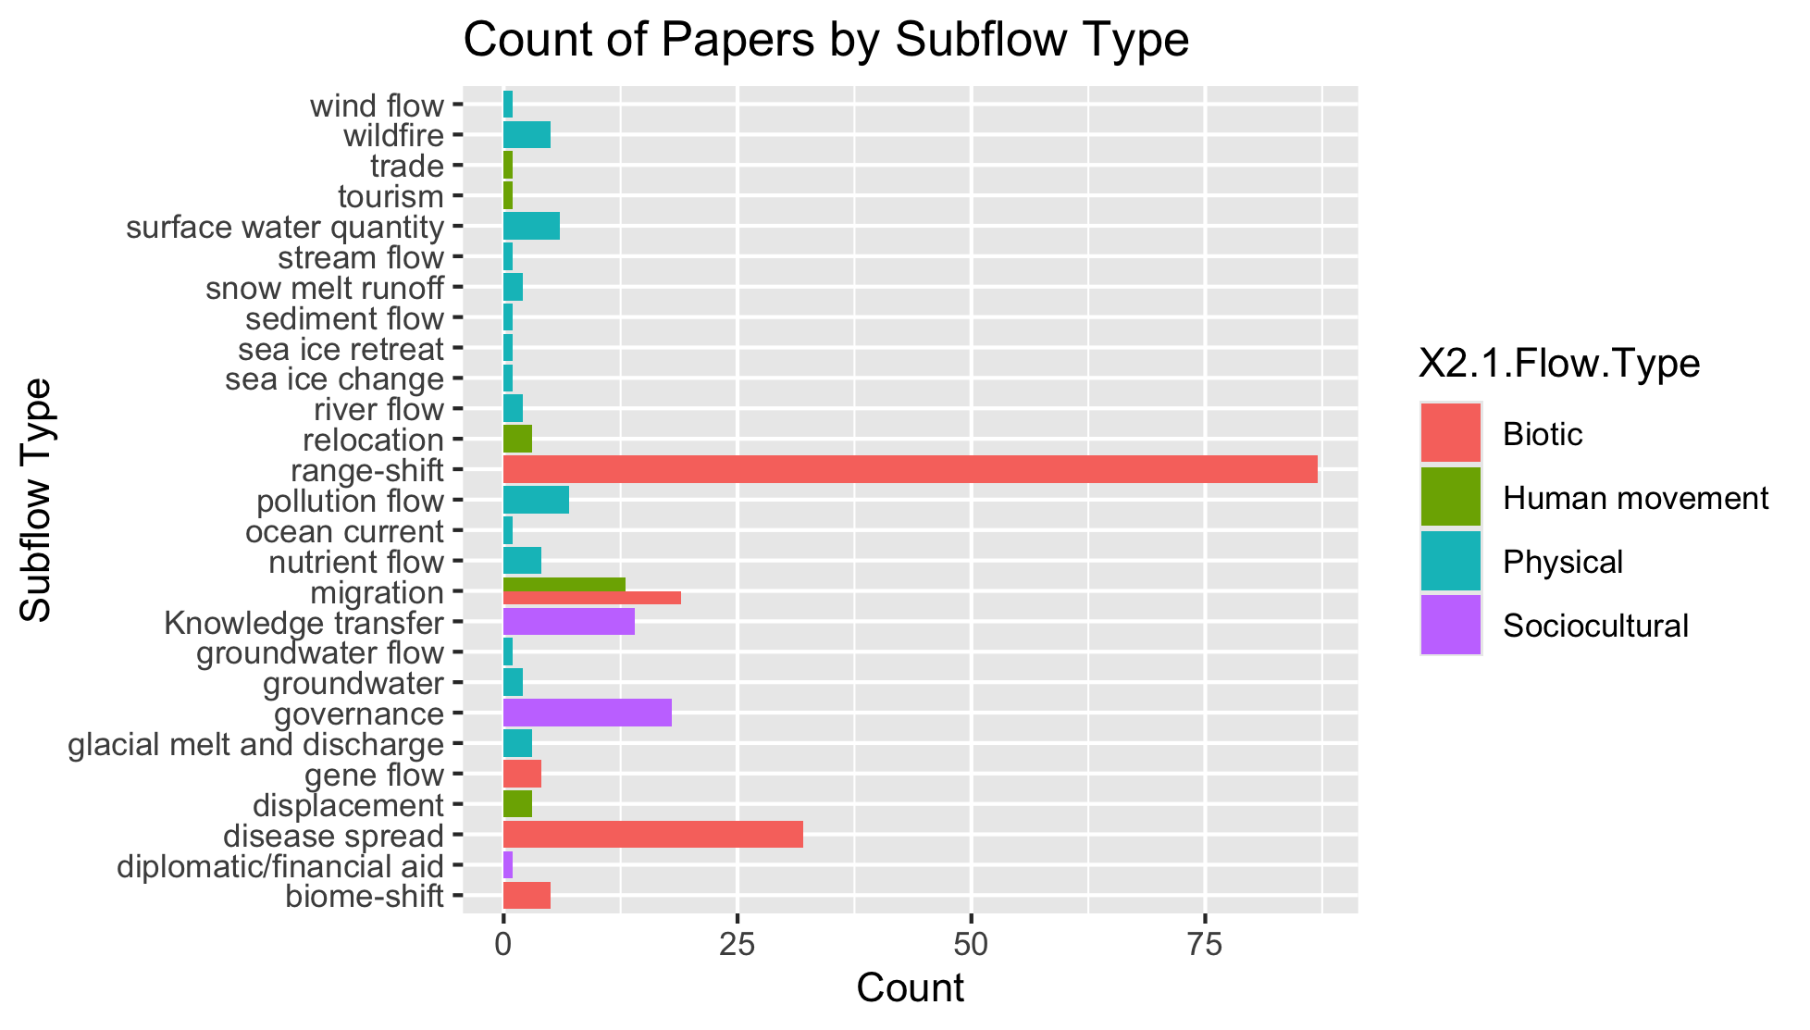
To group physical flow papers

Slide 20
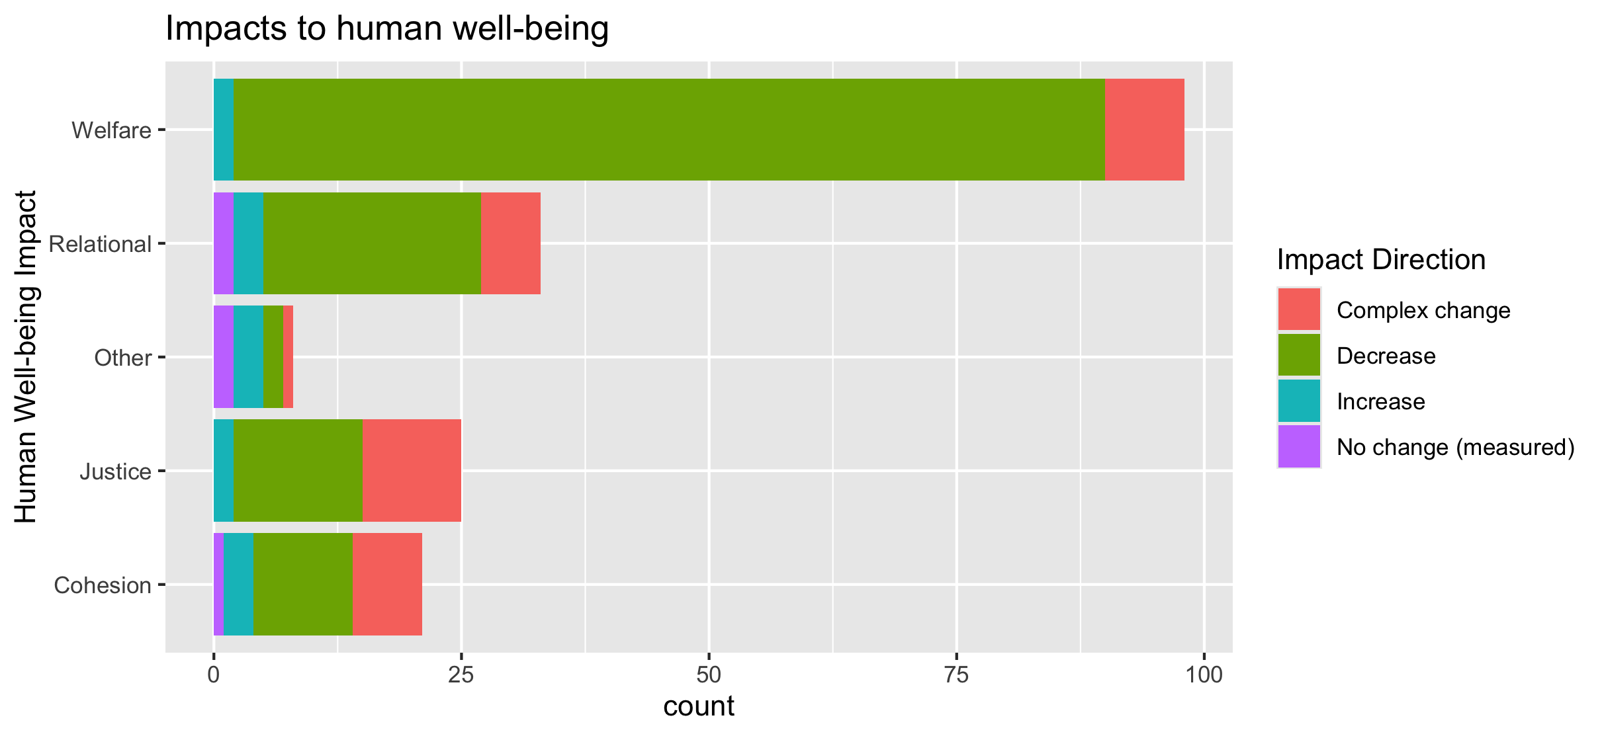
To align direction colors with final color pallet

Slide 21
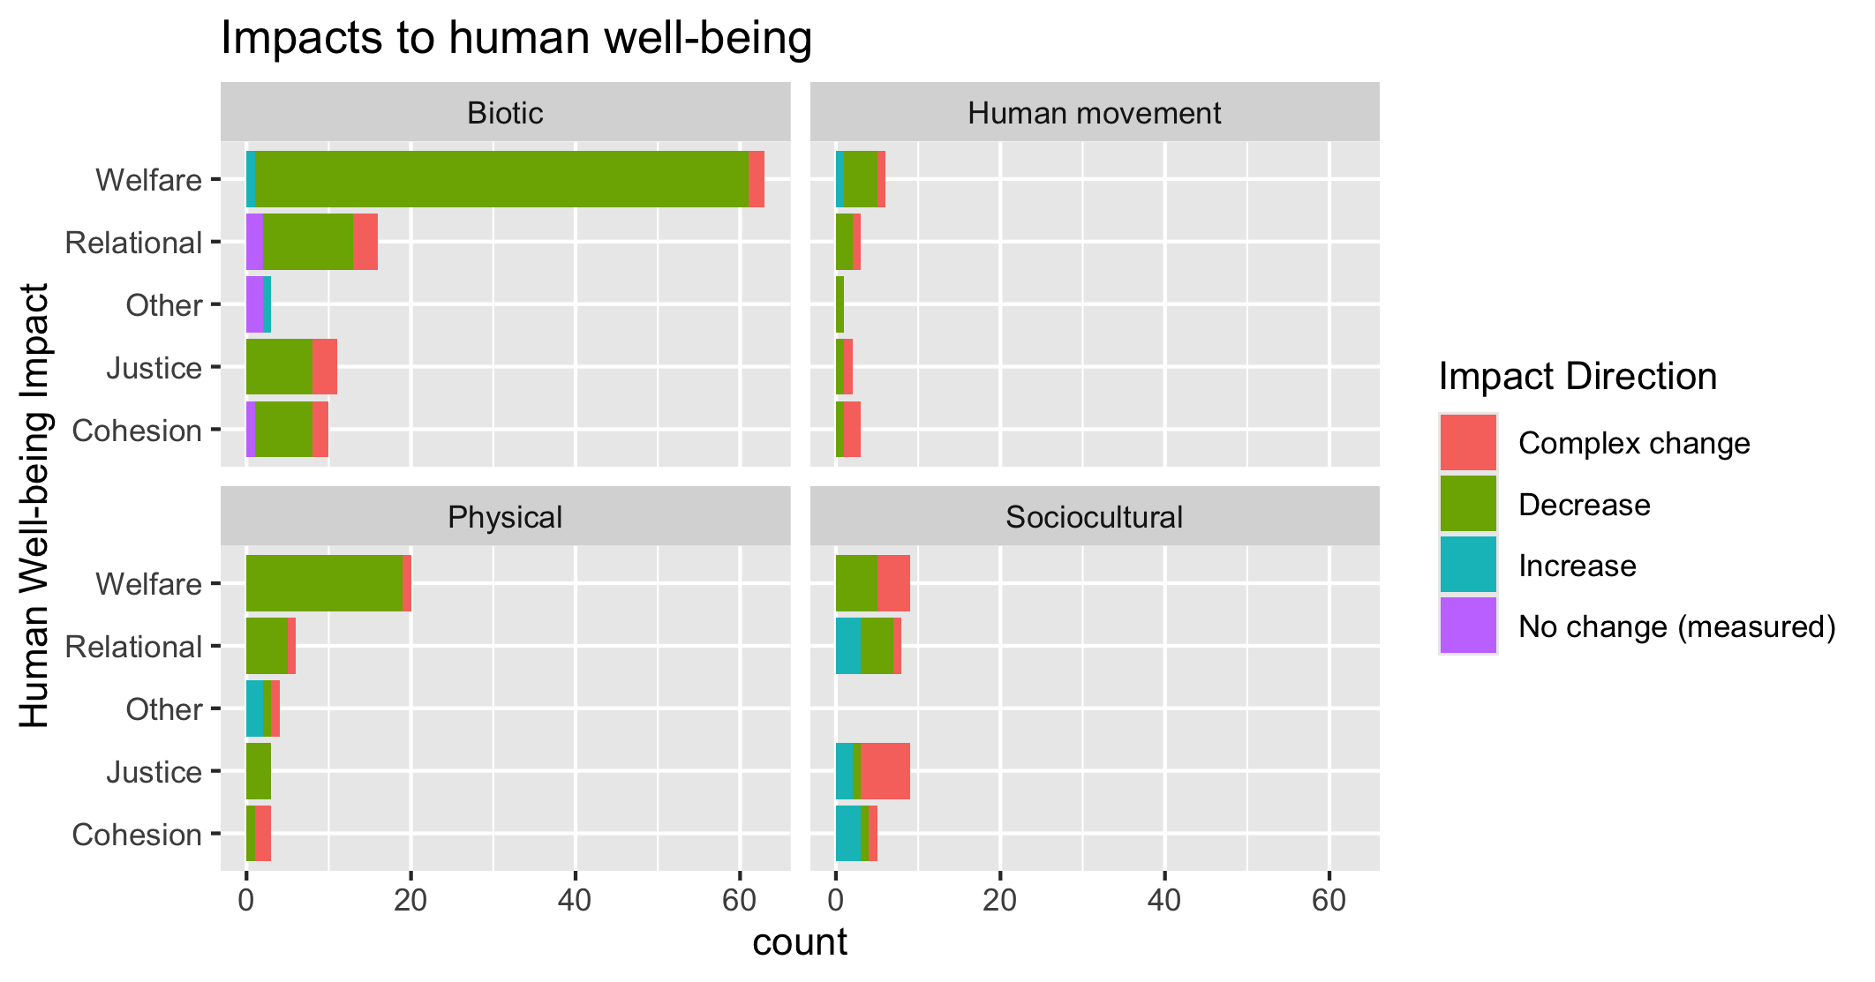
To align direction colors with final color pallet

Slide 22
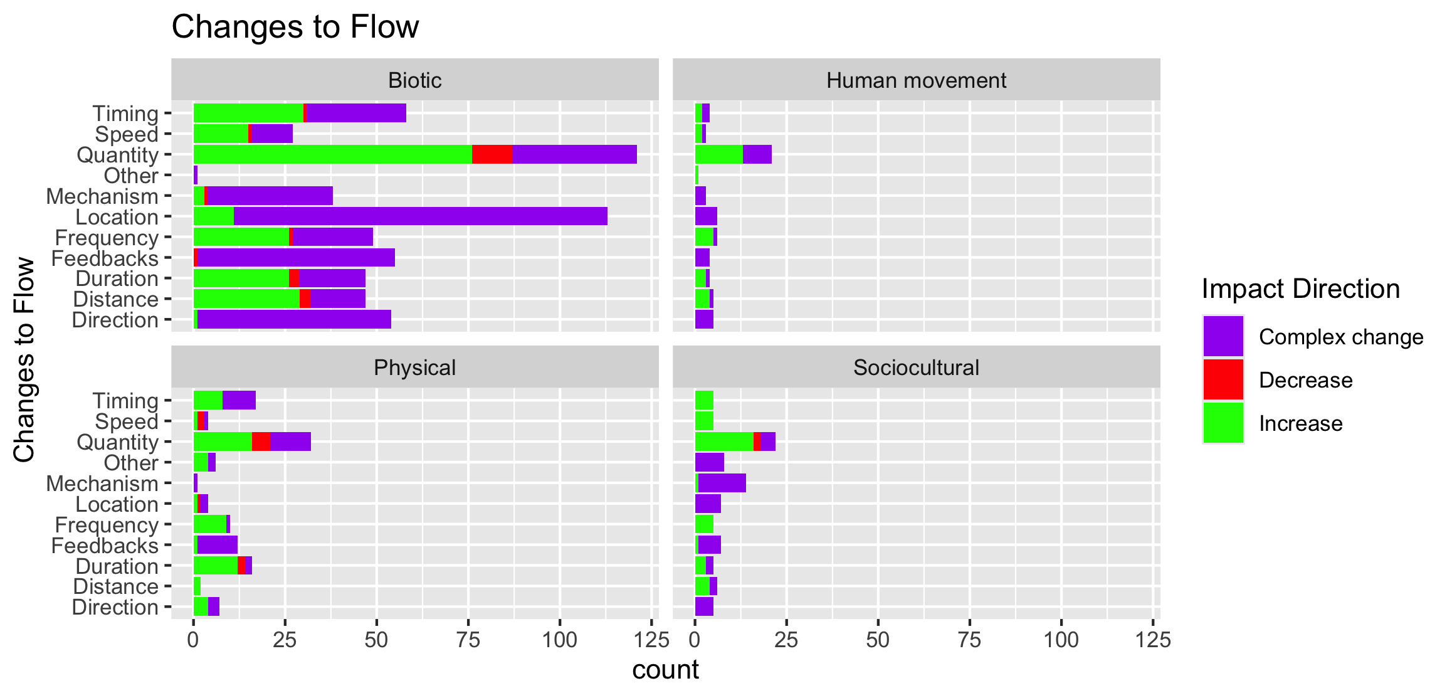

Slide 23
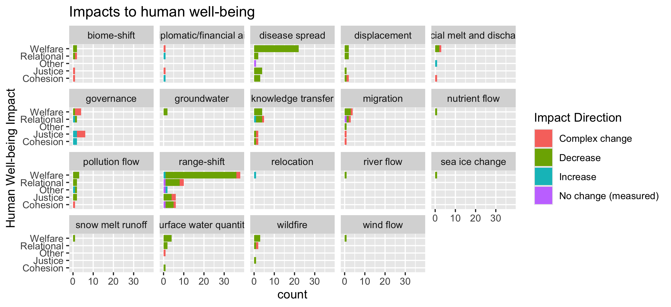
To group physical flow papers

Slide 24
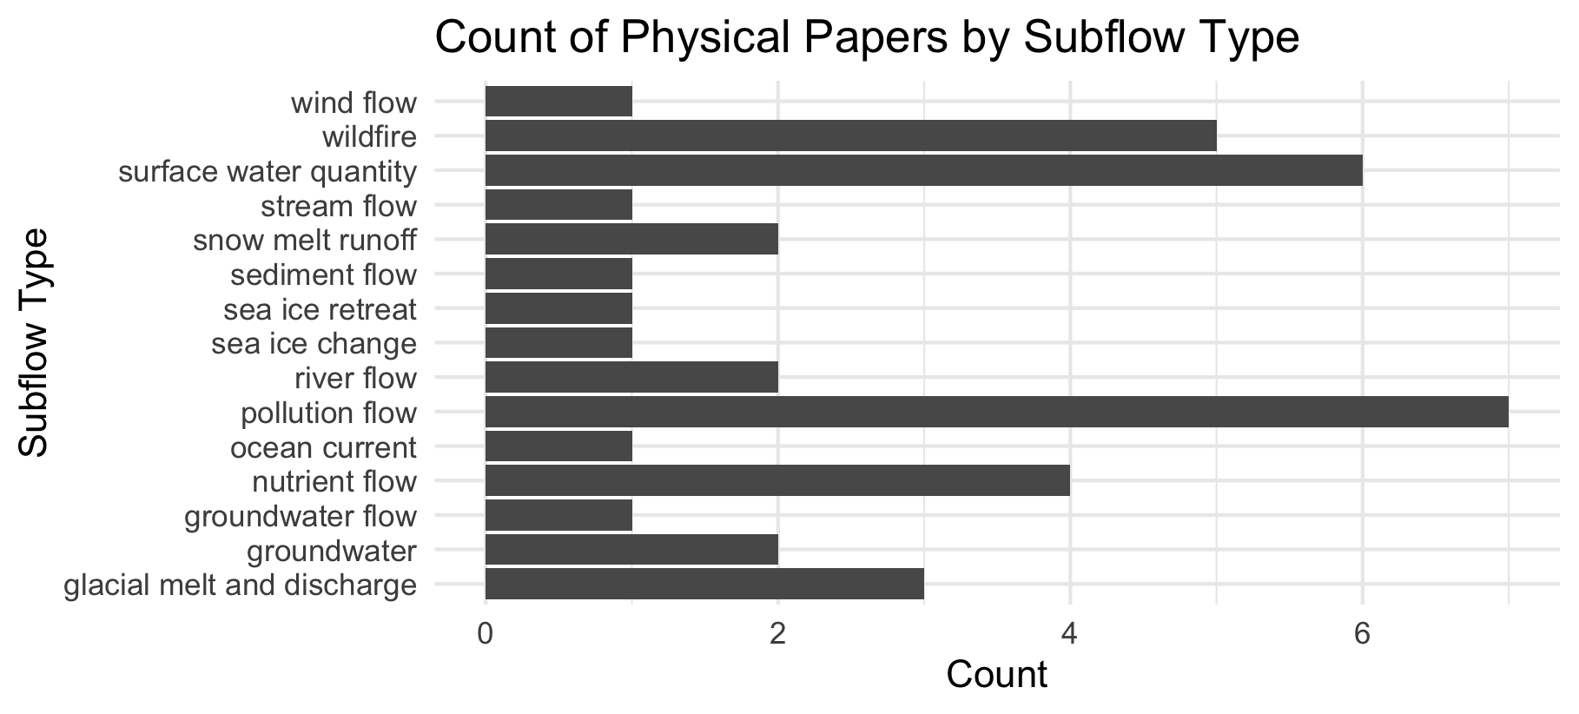

Slide 25
Feb 23 2025

Slide 26
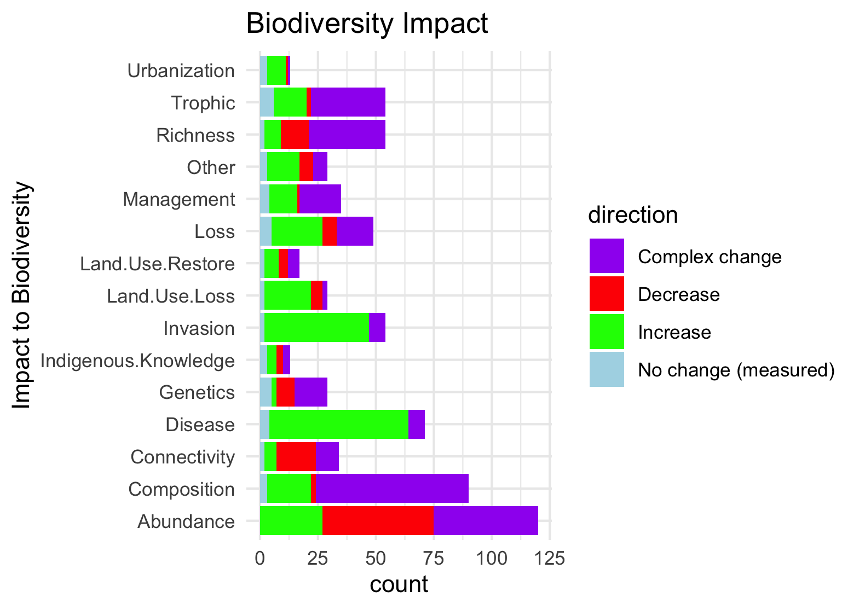
Needs to be grouped by what is good and what is bad to see increase in:

Slide 27
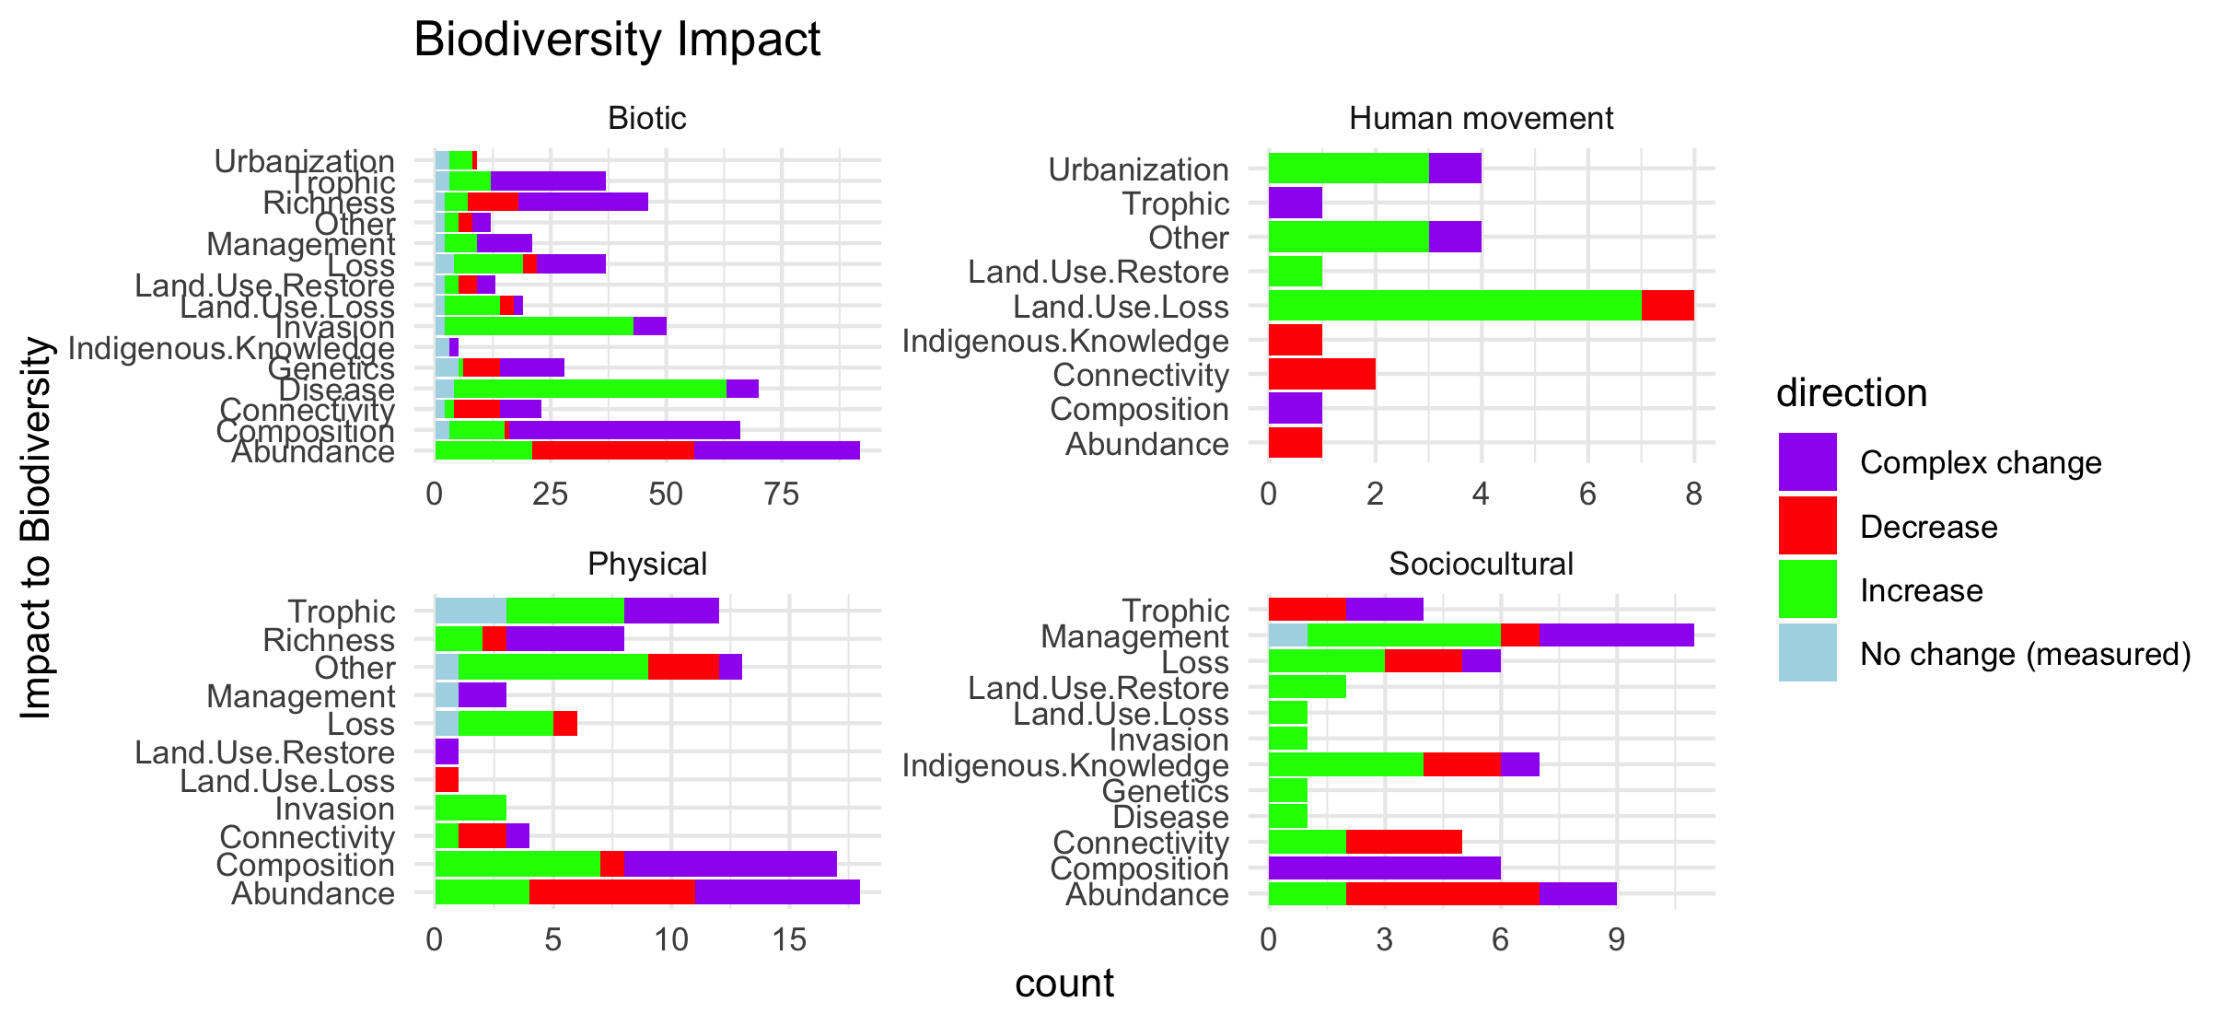
Scale free on the facet (diff x axis)

Slide 28
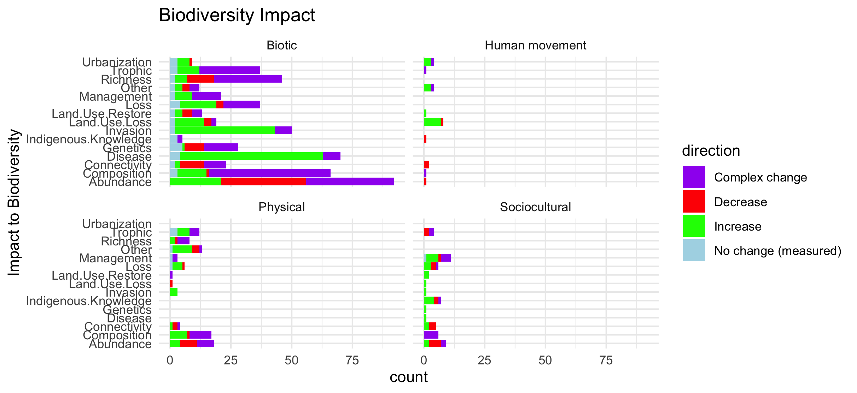
Scale fixed on the facet (same x axis)

Slide 29
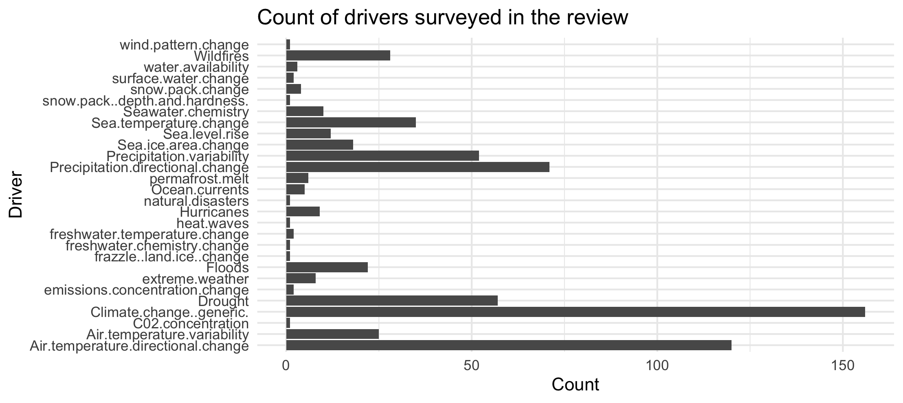

Slide 30
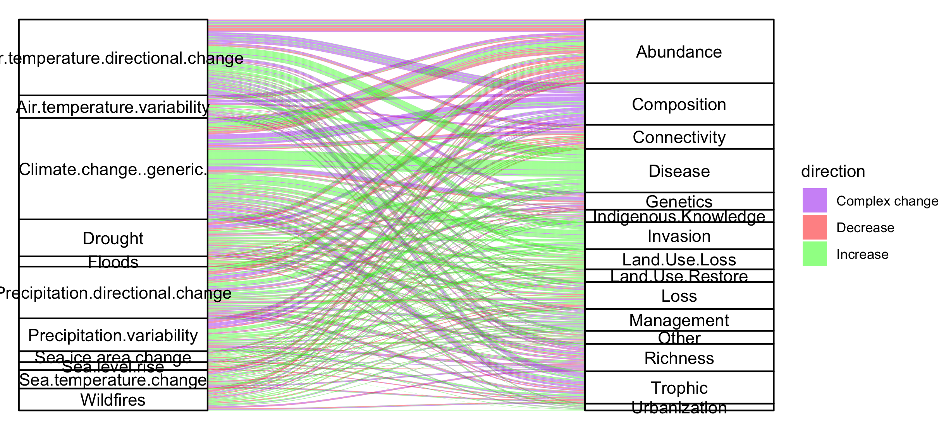
Colleen: see note isn the code – we could group spme of the drivers (hurricaines, extreme weather, ands ome of the ice ones). This still doesnt take into account if changes arw good or bad though and might just be too busy.

Slide 31
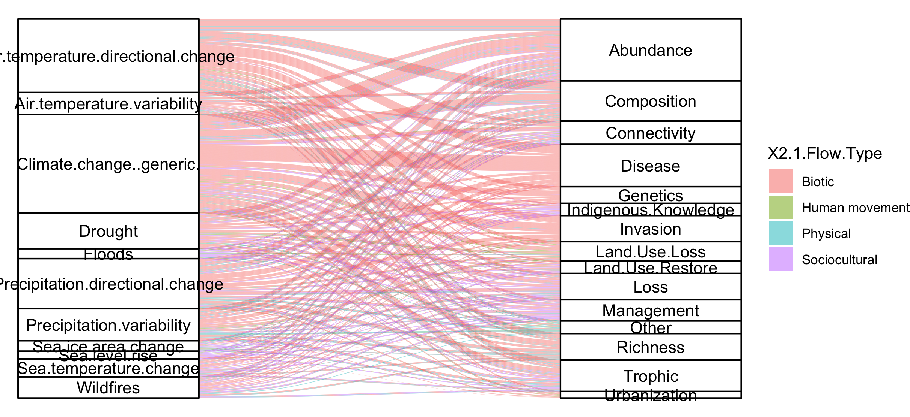
#not that informative because so many more of the papers are biotic

Slide 32
NCPs

Slide 33
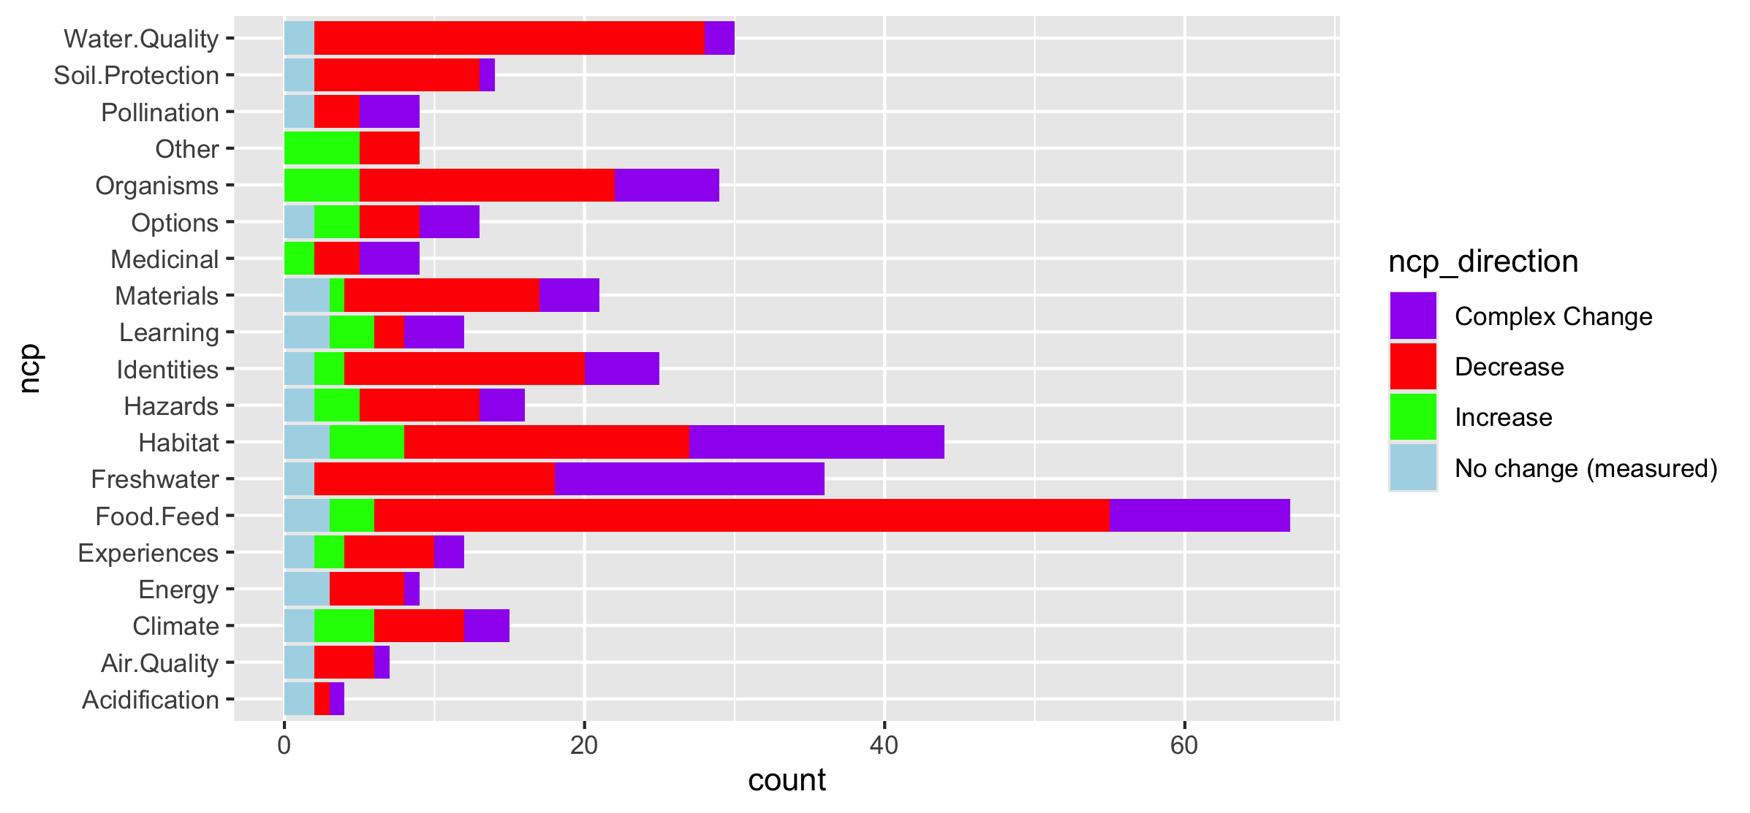
Fix labels

Slide 34
Do by flow type

Slide 35
Fix labels

Slide 36
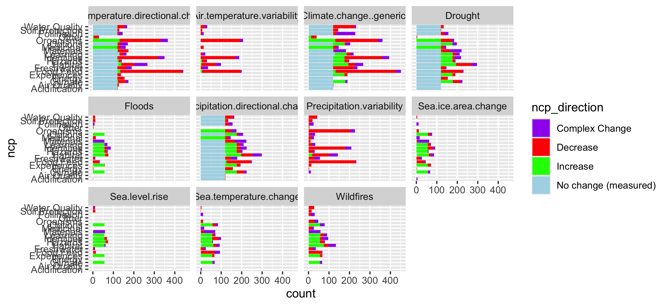

Slide 37
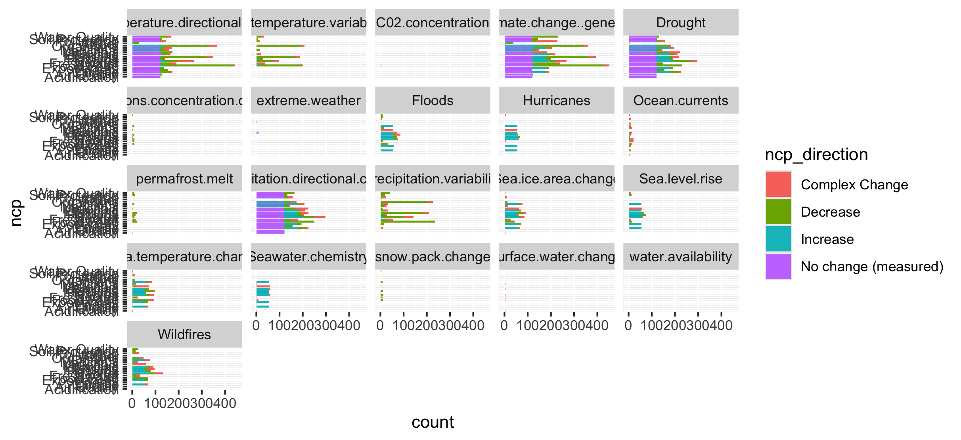
Too many drivers

Slide 38
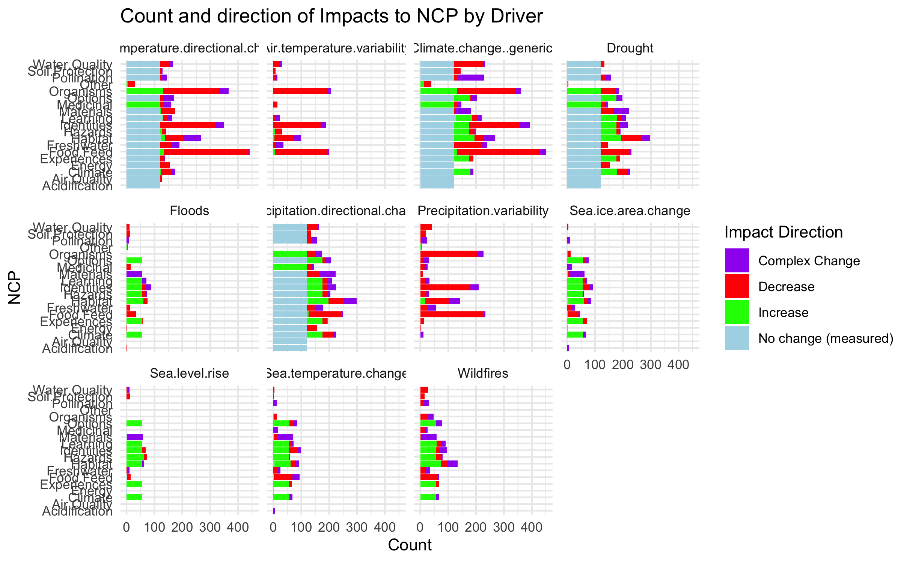

Slide 39
HWB

Slide 40
Connections – how does altered flow relate
Driver~ altered flow (by flow, and subflow – grouped out by flow
Altered flow~ impact (for each category)

